Slide 1



Notes:
Greetings! In this presentation, we will quickly introduce PrestaShop, a robust web application that will serve as the system under test throughout this course.

Slide 2
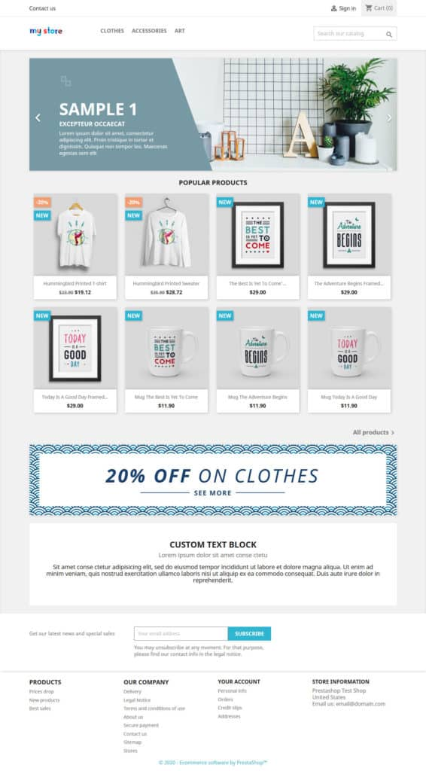
Notes:
PrestaShop is a software solution the creation of eCommerce websites. Although initiated by a private company, it is an open-source program that can be conveniently installed as a Docker container.

Slide 3

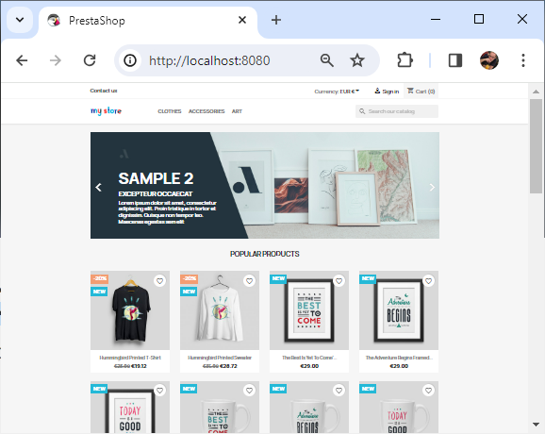
docker-compose.yml
1
version: '3'
services:
mysql:
container_name: some-mysql
image: mysql:5.7
restart: unless-stopped
environment:
MYSQL_ROOT_PASSWORD: admin
MYSQL_DATABASE: prestashop
command: sh -c "chmod 644 /sql-config.cnf"
networks:
- prestashop_network
volumes:
- ./init.sql:/init.sql
- ./sql-config.cnf:/sql-config.cnf
phpmyadmin:
image: phpmyadmin:5.2
container_name: phpmyadmin
links:
- mysql
environment:
PMA_HOST: some-mysql
PMA_PORT: 3306
PMA_ARBITRARY: 1
PMA_USER: root
PMA_PASSWORD: admin
restart: always
ports:
- "9090:80"
networks:
- prestashop_network
$ docker-compose up -d
Creating network "config_prestashop_network" with the default driver
Creating some-mysql ... done
Creating prestashop ... done
Creating phpmyadmin ... done
2
prestashop:
container_name: prestashop
image: prestashop/prestashop:8.1.3
restart: unless-stopped
depends_on:
- mysql
ports:
- "8080:80"
environment:
DB_SERVER: some-mysql
DB_NAME: prestashop
DB_USER: root
DB_PASSWD: admin
PS_INSTALL_AUTO: 1
PS_DOMAIN: localhost:8080
ADMIN_MAIL: demo@prestashop.com
ADMIN_PASSWD: prestashop_demo
PS_FOLDER_ADMIN: admina
networks:
- prestashop_network
networks:
prestashop_network:
3
Notes:
Assuming a docker desktop is installed and the docker-compose file shown here is in the directory, PrestaShop can be installed with a single command.

Slide 4
docker-compose.yml
1
version: '3'
services:
mysql:
container_name: some-mysql
image: mysql:5.7
restart: unless-stopped
environment:
MYSQL_ROOT_PASSWORD: admin
MYSQL_DATABASE: prestashop
command: sh -c "chmod 644 /sql-config.cnf"
networks:
- prestashop_network
volumes:
- ./init.sql:/init.sql
- ./sql-config.cnf:/sql-config.cnf
phpmyadmin:
image: phpmyadmin:5.2
container_name: phpmyadmin
links:
- mysql
environment:
PMA_HOST: some-mysql
PMA_PORT: 3306
PMA_ARBITRARY: 1
PMA_USER: root
PMA_PASSWORD: admin
restart: always
ports:
- "9090:80"
networks:
- prestashop_network
$ docker-compose up -d
Creating network "config_prestashop_network" with the default driver
Creating some-mysql ... done
Creating prestashop ... done
Creating phpmyadmin ... done
2
prestashop:
container_name: prestashop
image: prestashop/prestashop:8.1.3
restart: unless-stopped
depends_on:
- mysql
ports:
- "8080:80"
environment:
DB_SERVER: some-mysql
DB_NAME: prestashop
DB_USER: root
DB_PASSWD: admin
PS_INSTALL_AUTO: 1
PS_DOMAIN: localhost:8080
ADMIN_MAIL: demo@prestashop.com
ADMIN_PASSWD: prestashop_demo
PS_FOLDER_ADMIN: admina
networks:
- prestashop_network
networks:
prestashop_network:
3
Notes:
Once installed, it can be accessed in a browser using a local address.

Slide 5

Notes:
In this course, we will automate some basic operations related to the shop.

Slide 6

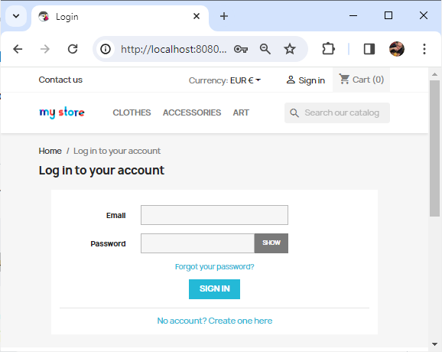
Notes:
We will use the login interface, where users input their username and password and then click on the ‘Sign-in’ button to access the shop.

Slide 7

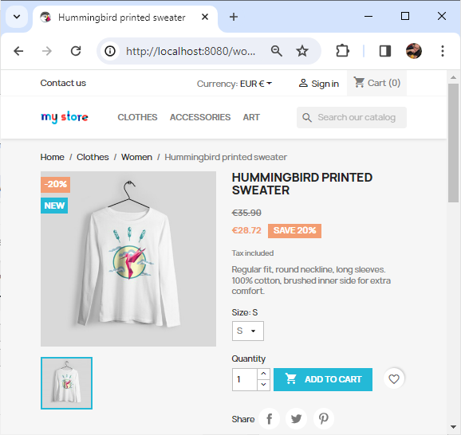

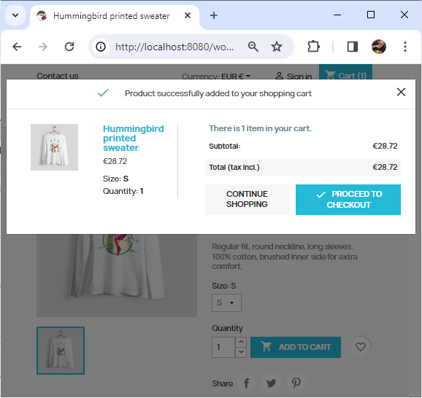
Notes:
We will also add items to the shopping cart and proceed to checkout items.

Slide 8
Notes:
This brings us to the end of our presentation. We have presented the PrestaShop web application, which will serve as our platform for demonstrating Provengo throughout this course.

